Slide 1
Requirement Document
Project Name: Sales management system
Development Group: CS-SW-AO3
Presentation Is Prepared By:
Shaheen Sadatzai
Faisal Azizi

Slide 2
Business Requirements
A super store is facing problems in to compete with it's counterpart's
because of the lack of a good record keeping system .They are not able to
have a exact records of the deals with there customers and supliers. And how much
loan they have on there customers . Beside this some times they don't have
information about there stock whether an item is available or not so if it'
s not available they can't provide items to customers on time that is why
they are losing customers day by day . And the can't identify there long term
customers to give them extra discount.
- So an information system is needed to solve all the problems of the super store .

Slide 3
User Requirements
-The system should provide the exact record of each customer and suppliers .
And the system should alert the store keeper if an item is not being left in the stock . And the list of the available items and there price
And items bought from suppliers and there price. generate reports about the items sold ,profits etc.
and the loans of suppliers on the super store.

Slide 4
User Requirement Specification
-System should just accessed by a single authorized administrator through a password.
-The system should store the following info about the an Item(name ,price ,amount , supplier).
-if the amount of the items is less than 10items in the stock the system should alert the keeper.
-The system should generate an items report which will contain all current available items and there Name , amount ,price and supplier.
-And another report for all sold items of current month or a specified month.
-Generate the year base reports.

Slide 5
Continue…
-Report for those items which are not being sold for more than a year . and are available at stock.
-The system should store the info about the customer(name , fName ,address , phone , Record of sales on
Customer , start of deal(date)).
-report of list of all customers.
:- if the customer deals with store for more than 3 Years then a 5% discount should be given.

Slide 6
Continue…
if the customer don't come for purchasing for more than 3 years the record should be deleted.
-The system should store the info about the supplier(name ,records of supplied items , start of deal).
-report of list of all suppliers.
if we don't buy the items from a supplier for more than 3years then record should be deleted automatically.

Slide 7
Functional Requirements
Functional requirement are showing the functionality of the system
That should be provided to fulfill the demands of the user.
Here we have used the Use Cases for showing the functionality and
The interaction of the user with system and the behavior of the system.

Slide 8
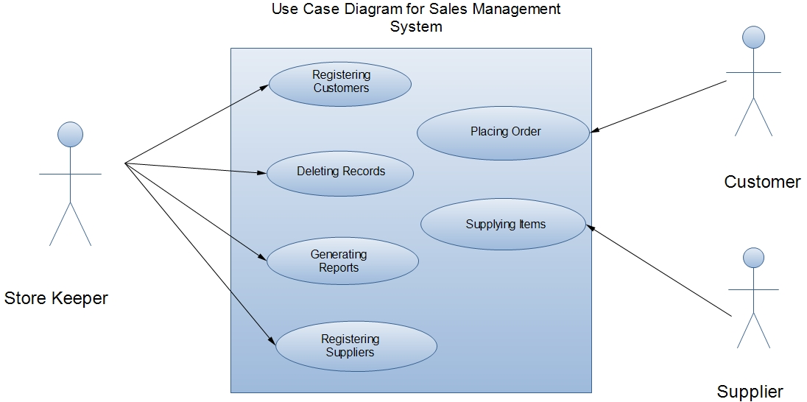
Sales Management System ( Use Cases)

Slide 9
Registering Customers(Use Case)
Scenario:
When a customer places an order then the store keeper should firstly register the customer and then fulfill the order.
Precondition:
Before registration the customer should not be registered with the
System.
Post condition:
After registration the customer should be registered with the System.
Exception:
If the customer is being registered before. The registration should be canceled.

Slide 10
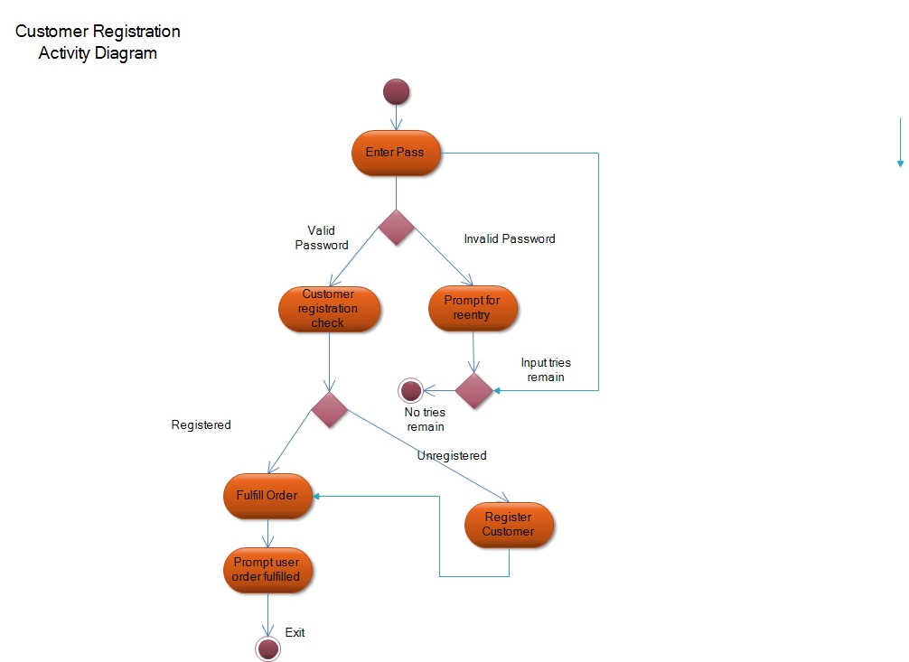
Activity Diagram (Registering Customers)

Slide 11
Deleting Records
Scenario:
When the store keeper wants to delete a record then he/she
Select a record and perform the deletion.
Pre condition:
The record should exist.
Post condition:
After performing the delete operation the record should be removed.

Slide 12
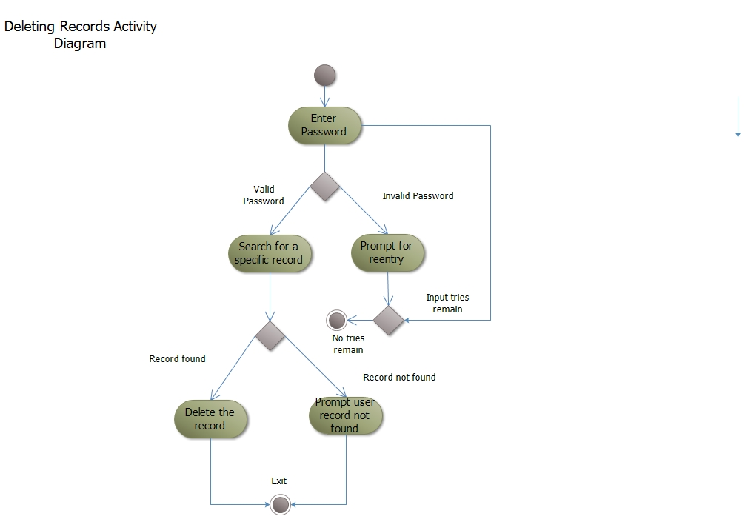
Activity Diagram (Deleting Records)

Slide 13
Report Generation(Use Case)
Scenario:
The Store keeper can generate different kind of reports from the System.
Pre condition:
The Data should exist in the system for report generation.

Slide 14
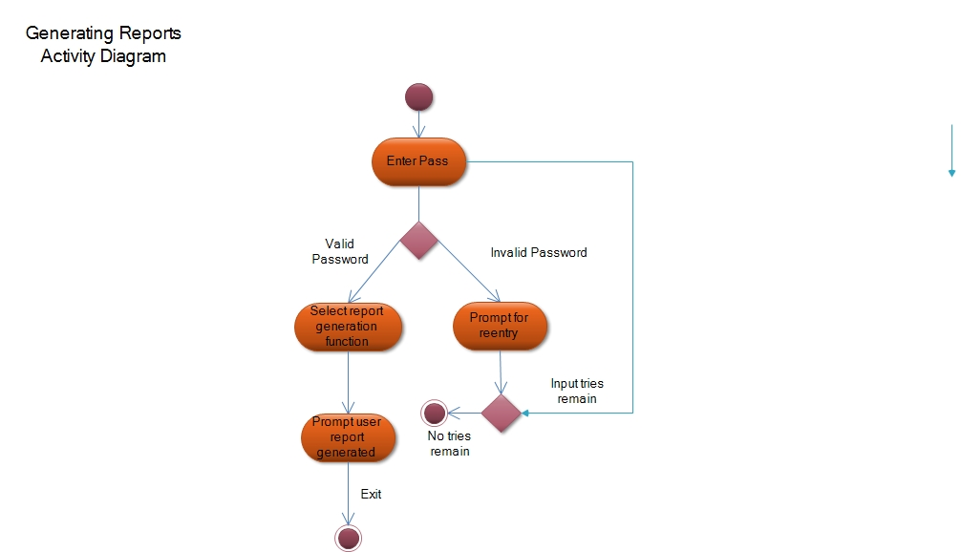
Activity Diagram(Deleting Records)

Slide 15
Storing Purchased Items(Use Case)
Scenario:
The store keeper should store the purchased items into the database .Firstly the supplier registered.
Pre condition:
The supplier should be registered before storing the records.
Post condition:
All the records of this purchase should be present database.

Slide 16

Activity Diagram (Storing Purchased Items)

